Slide 1
Presentation
On Small Patch
By Lucinda Hu
EXAMPLE.COM

Slide 2
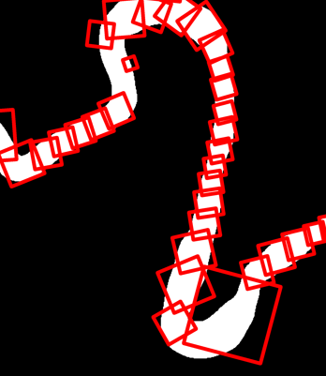
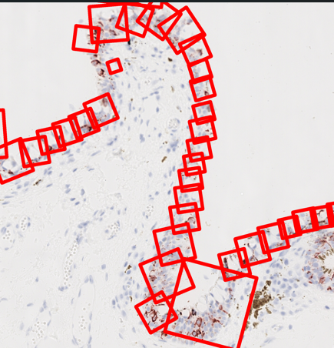
Case 105 Melan Match#1
PORTFOLIO
Design Agency Name
#
EXAMPLE.COM

Slide 3
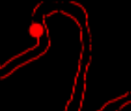
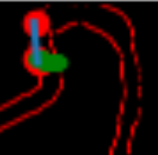



Normal & Tangent of Similar Point
Nearby Shape That functioned normally
Tangent and Normal
Similar direction and shape of patches that worked correctly

Slide 4
Reason of Having this Patch
The model is heavily dependent on the direction of tangent and normal.
For that small patch, it is very likely that the tangent is pointing outwards to the background rather than the center of epithelium. This result the extended path of the normal and tangent and patching square didn’t capture the width of epithelium
It may be related to how the code selected this point based on the mask, in which the point potential too close to the edge of epithelium after gaussian smoothing
Issues with selecting the right point for certain atypical curvatures based on the mask?
It can also be seen that in general, this patch is very similar to the direction of other correct patches on the right, but wrong starting point may have led to this issue

Slide 5
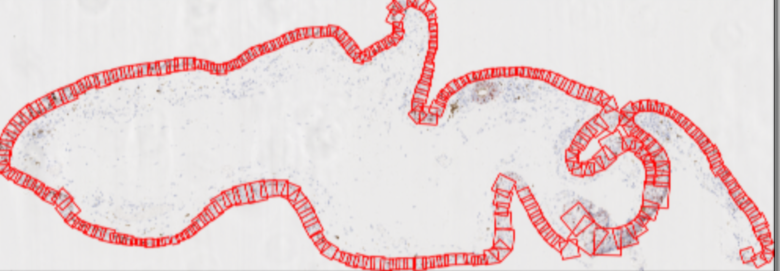
Worth-noting:Last version product right patch

Slide 6
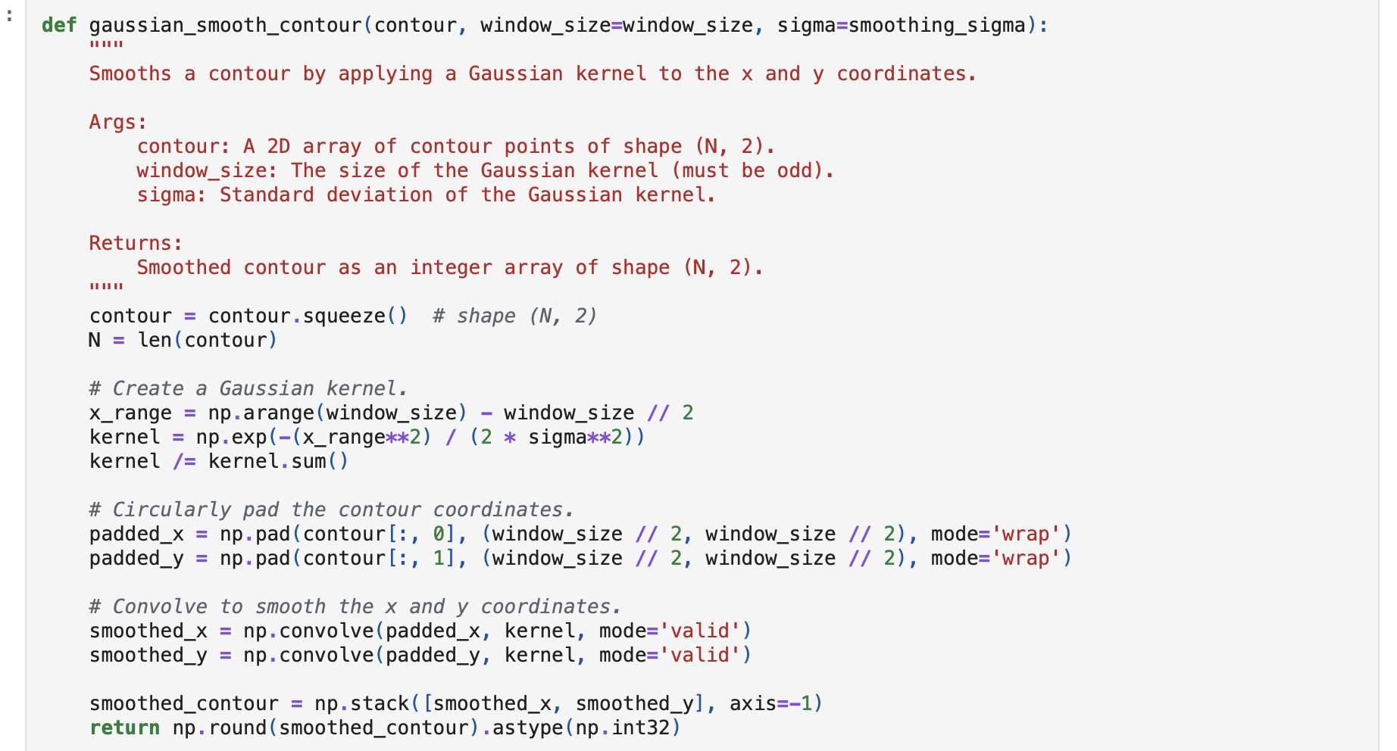
Difference
Over-smoothing? Parameter Calculation —— Curve points at certain angle —— Normal and Tangent in wrong direction and stopped

